Slide 1

Digital Portfolio
STUDENT NAME: M. ABISHEK
REGISTER NO AND NMID: 710AE3B96E2BA628CEE448836E71A6EA
DEPARTMENT: Computer science
COLLEGE: Puratchi thalaivi amma arts and science college, palladam

Slide 2
Project Tittle :DIGITAL Portfolio - M.Abishek
modern protfolio website with a clean,responsive,and user-friendly design
it includes dark mode feature and smooth animations
sections:
About me
skills
project
certificate
contact

Slide 3

AGENDA
Problem Statement
Project Overview
End Users
Tools and Technologies
Portfolio design and Layout
Features and Functionality
Results and Screenshots
Conclusion
Github Link
3/21/2024 Annual Review

Slide 4
PROBLEM STATEMENT
In today’s competitive enviroment,showcashing technical skills,projects,and Achievements is essential for carrer growth.Traditional resumes are limited In presenting interactive and visual content.There is a need for a Modren,responsive,and personalized protfolio website that highlights my Skills,projects,and certicates in a professional way.

Slide 5
PROJECT OVERVIEW
The Digital Portfolio website is a personal website built to highlight academic Background, technical skills, projects, certificates, and contact details. It Provides recruiters and peers with a professional, interactive, And modern Way to view achievements.

Slide 6

WHO ARE THE END USERS?
Recruiters/HR Managers
College Faculty for Evaluation
Fellow Developers & Collaborators
Internship/Job Providers

Slide 7
TOOLS AND TECHNIQUES
Frontend: HTML5, CSS3, JavaScript
Icons: Font Awesome
Animation & Effects: Typing effect, Dark mode toggle, Smooth scrolling
Hosting: GitHub Pages
Tools:TrebEdit

Slide 8
POTFOLIO DESIGN AND LAYOUT
Clean, modern single-page layout
Sections: Home, About Me, Skills, Projects, Certificates, Contact
Responsive design with dark mode support
Smooth navigation and UI-friendly interactions
8

Slide 9
FEATURES AND FUNCTIONALITY
About: Quick self-introduction & career goal
Certificates: Showcase of achievements
Experience: Past projects & work history
Education: Academic background timeline
Skills: Technical & soft skills highlight
Contact: Easy communication (Email, Phone, Social links)

Slide 10
RESULT
Working portfolio website hosted online
Successfully displays personal details, projects, and certificates
Easy navigation and user-friendly UI
Attracts recruiters by showcasing both skills and creativity
3/21/2024 Annual Review
10

Slide 11
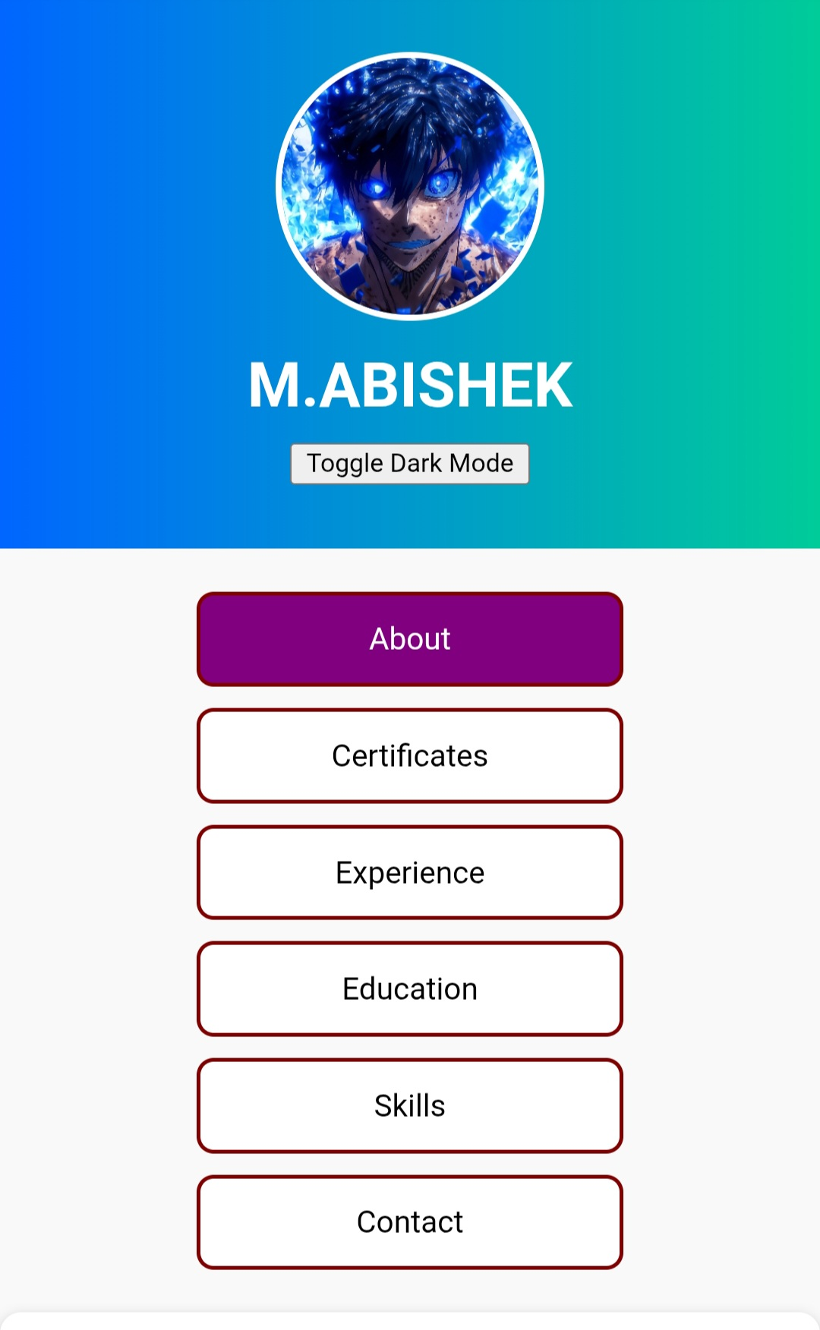
Screen shot 1
11

Slide 12
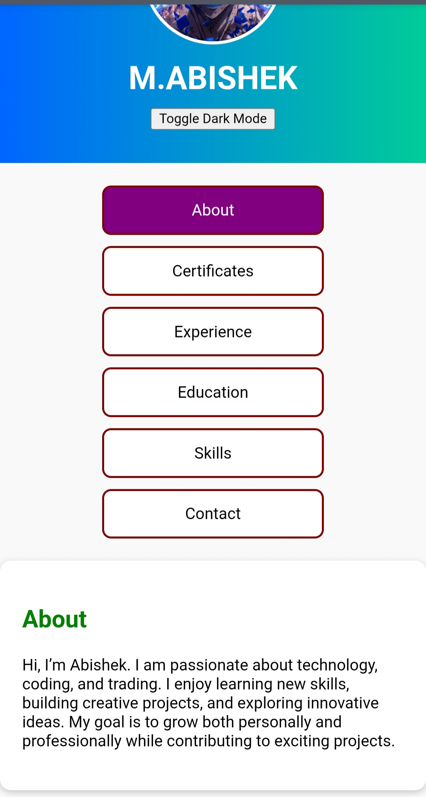
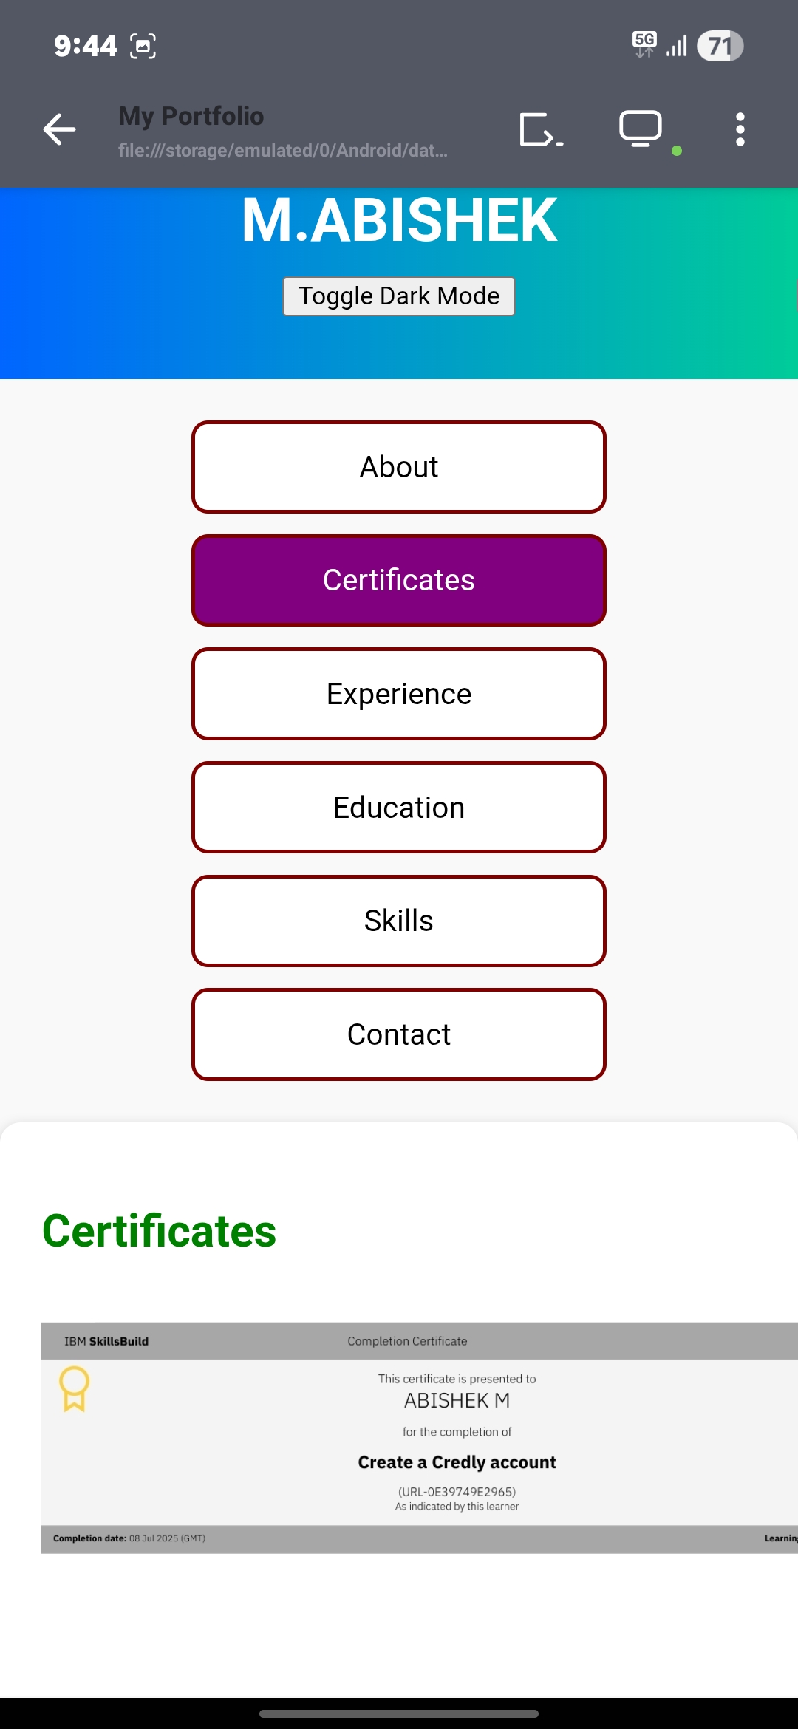
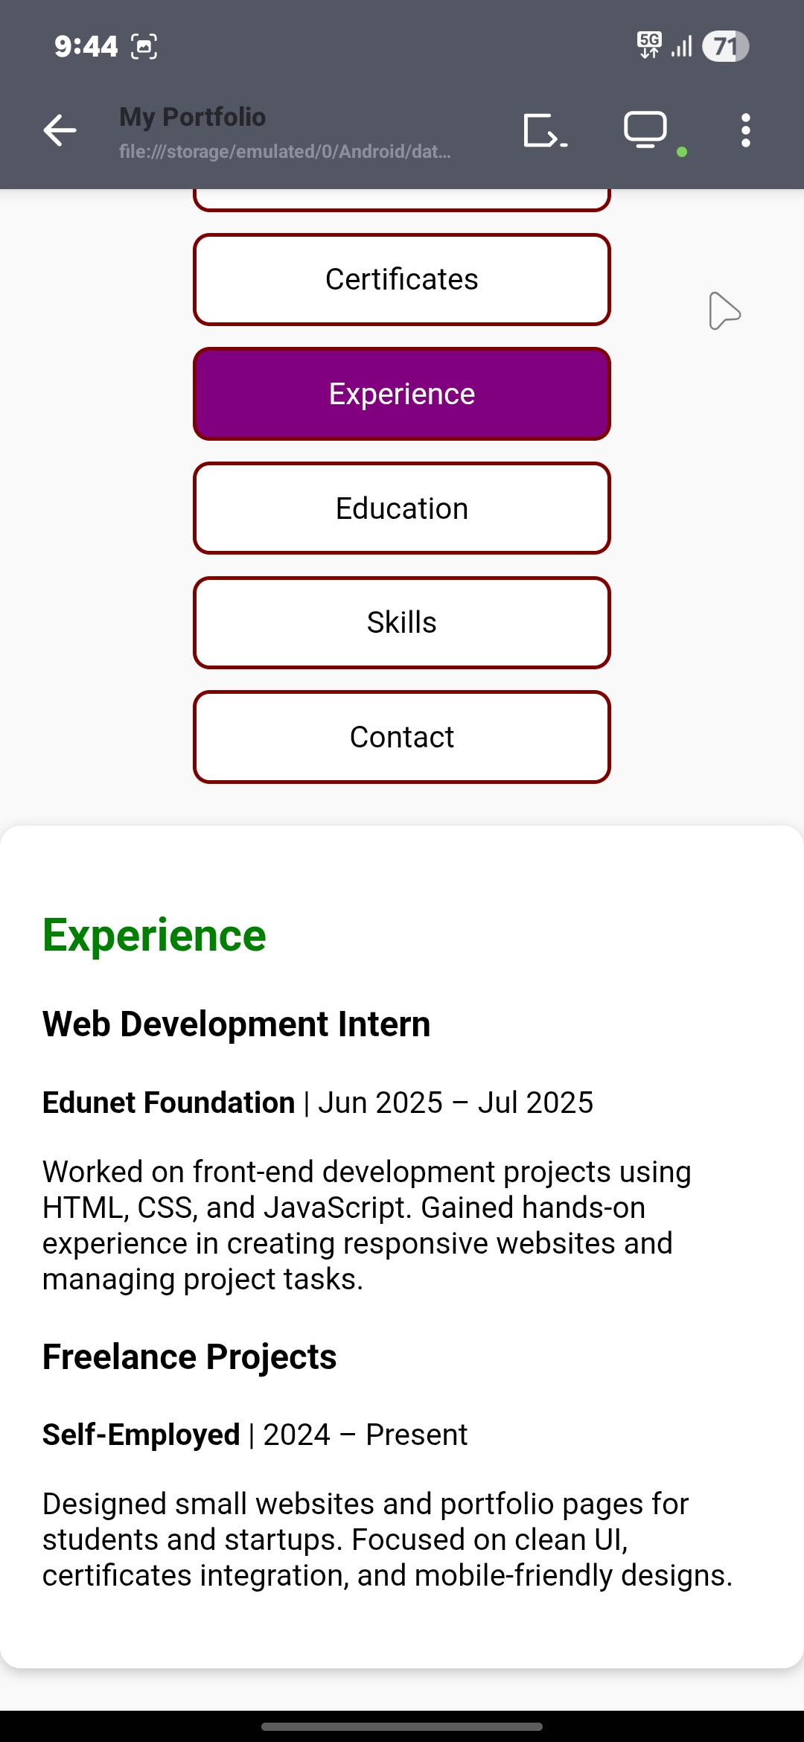
Screen shot2

Slide 13
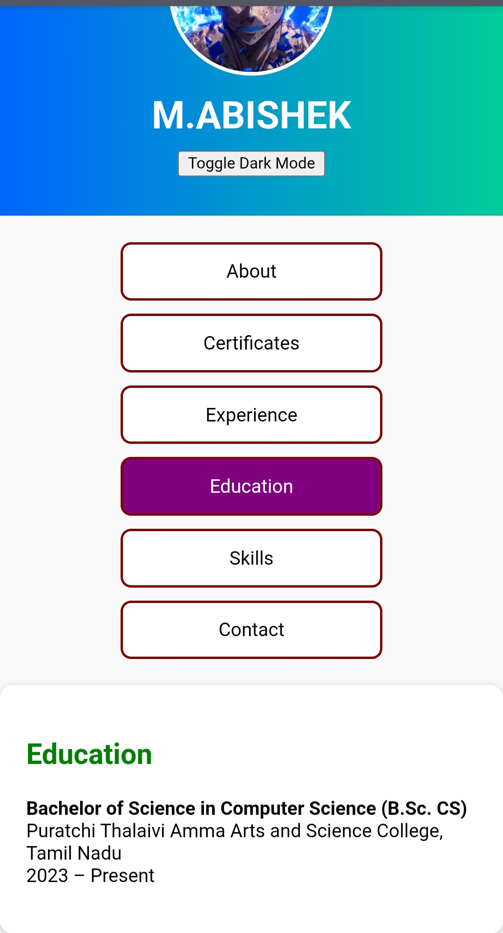
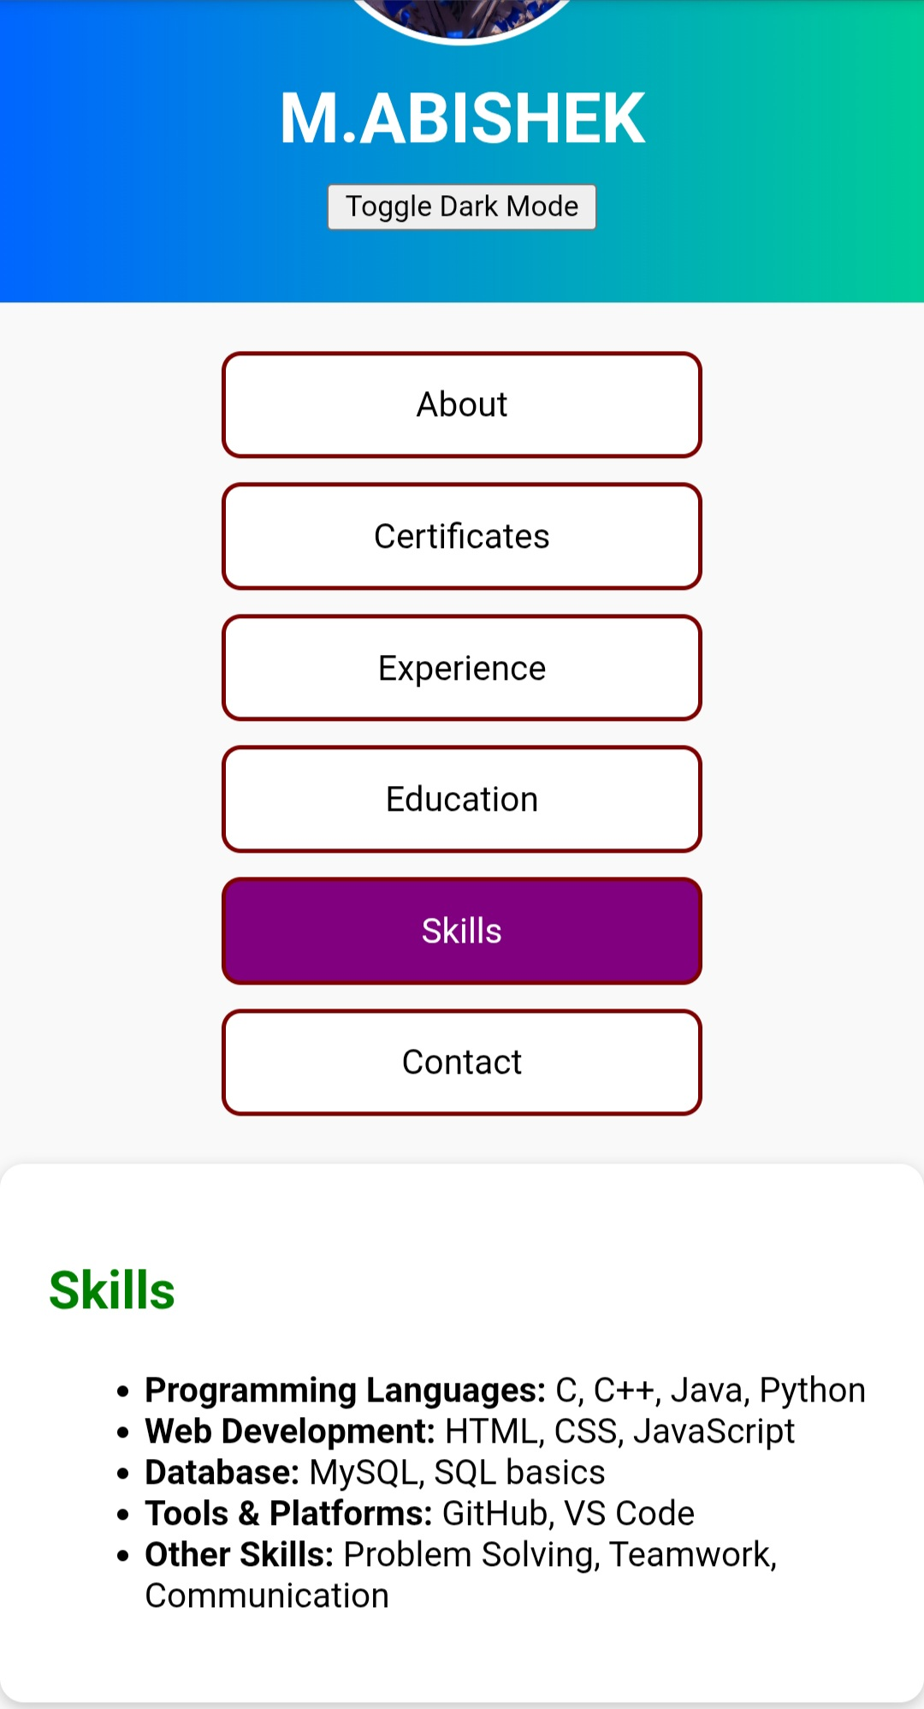
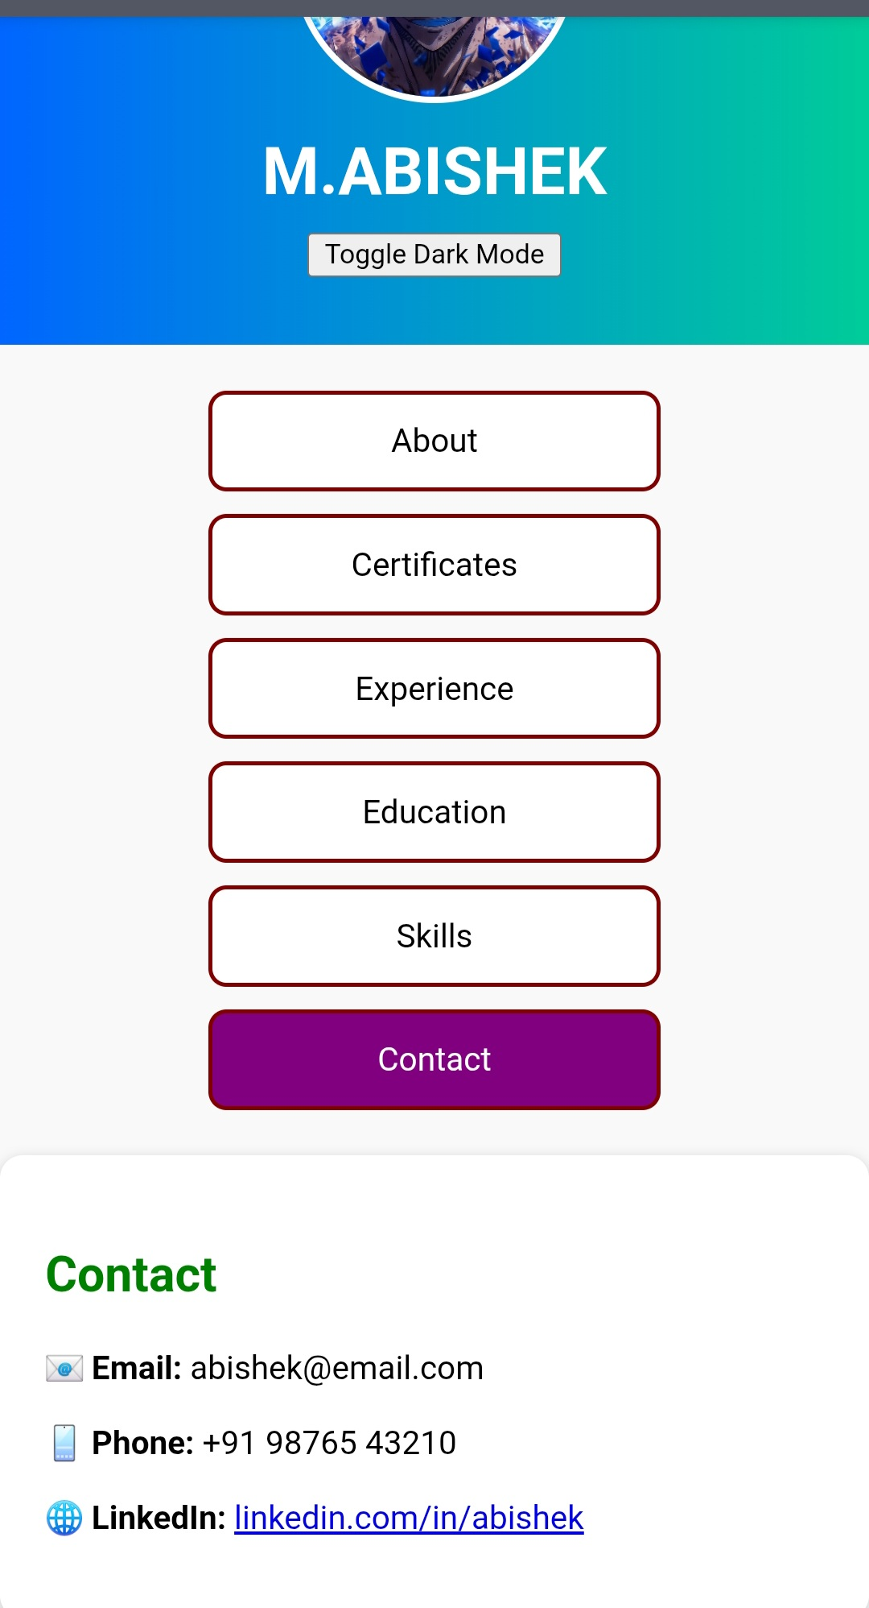
Screen Short 3

Slide 14
Conclusion
The digital portfolio acts as a modern resume, improving online visibility, Professionalism, and opportunities for internships and jobs. It Demonstrates both technical skills and personal branding.

